Slide 1
Design of a Wearable and Portable NIEV
APS 490 - SickKids Team
By: Yi Ling Soh, Vanessa Jade Tan, Jimin Kwon, Mona Murphy, Suhail Anuar

Slide 2
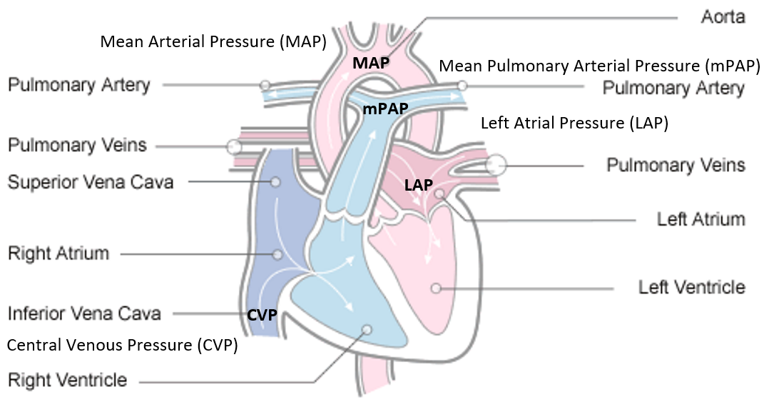
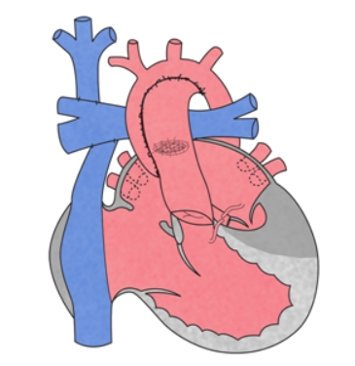
Normal vs Fontan Heart

Slide 3
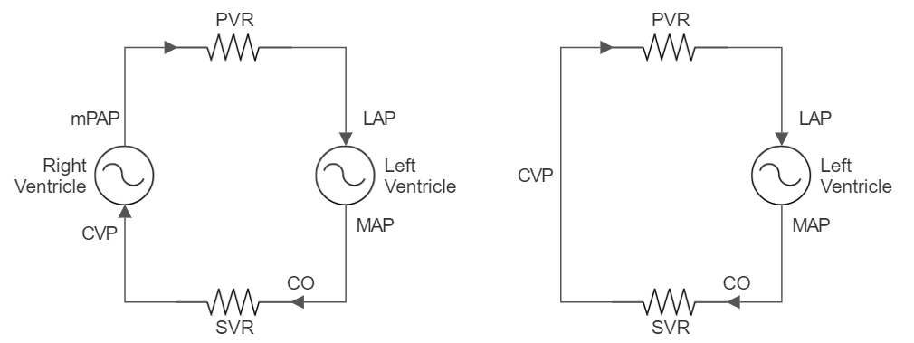
Analogy

Slide 4
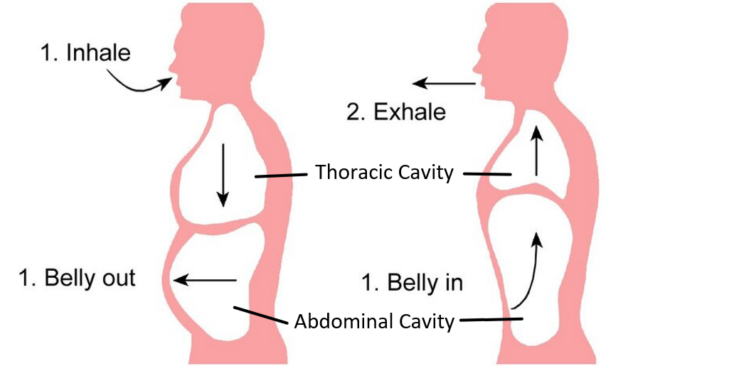
Respiratory Pump

Slide 5
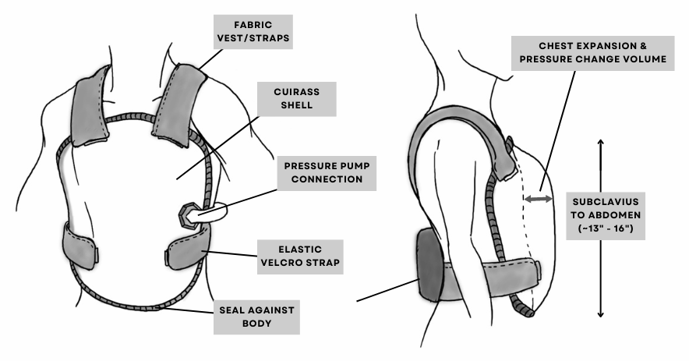
Cuirass

Slide 6
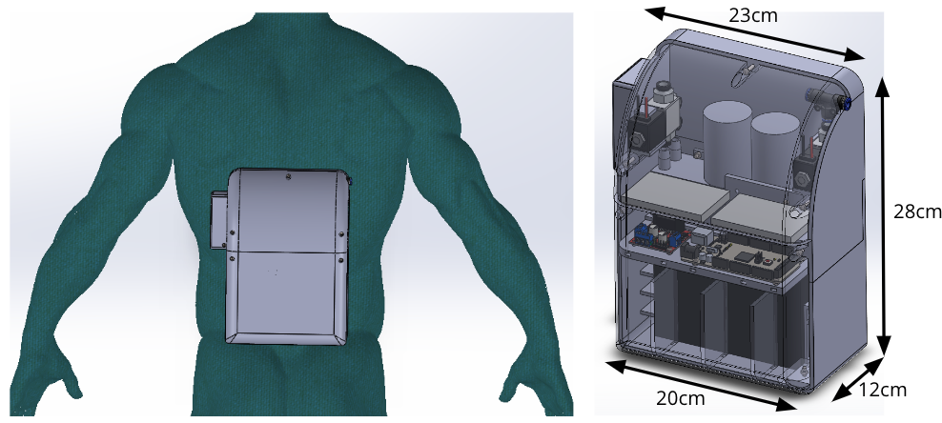
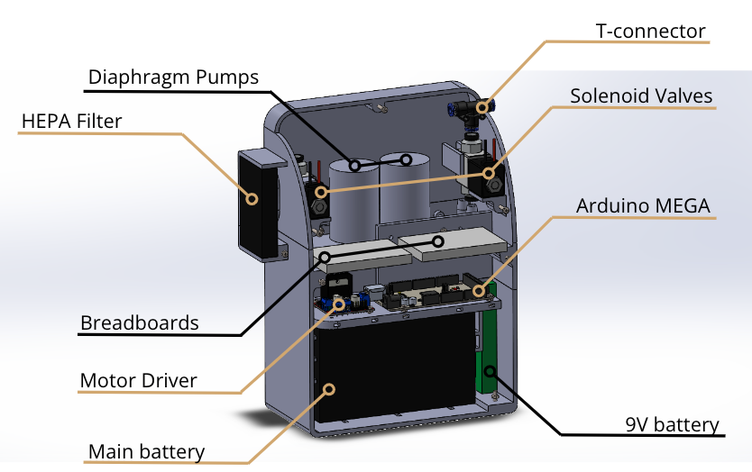
Backpack Module

Slide 7
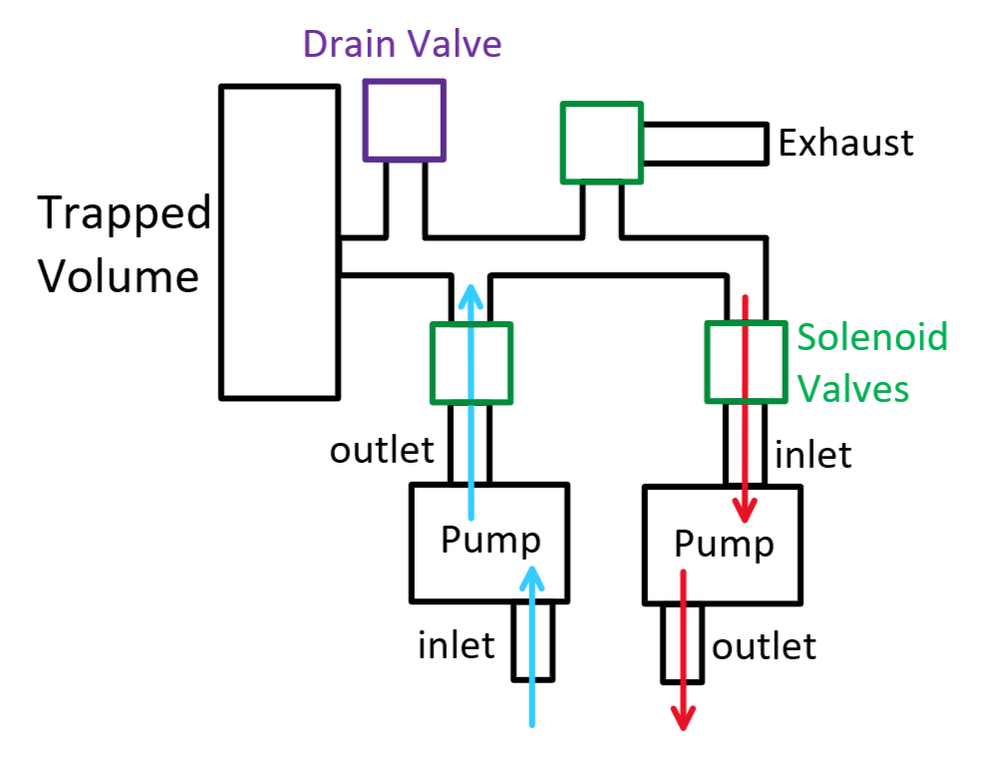
Pump Mechanism

Slide 8
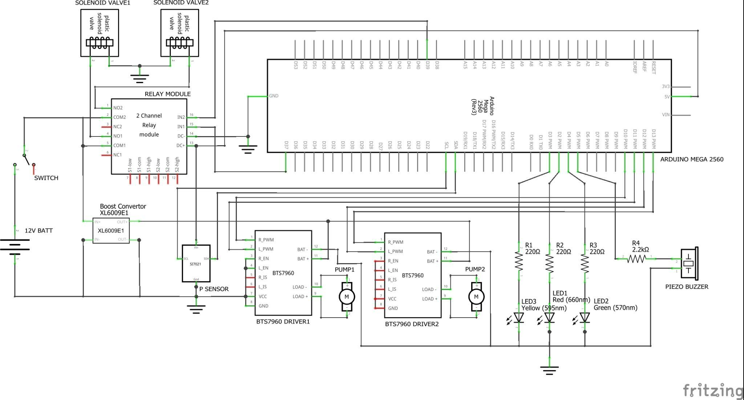
Schematic

Slide 9

NPV - Demo

Slide 10
BPV - Demo

